Slide 1
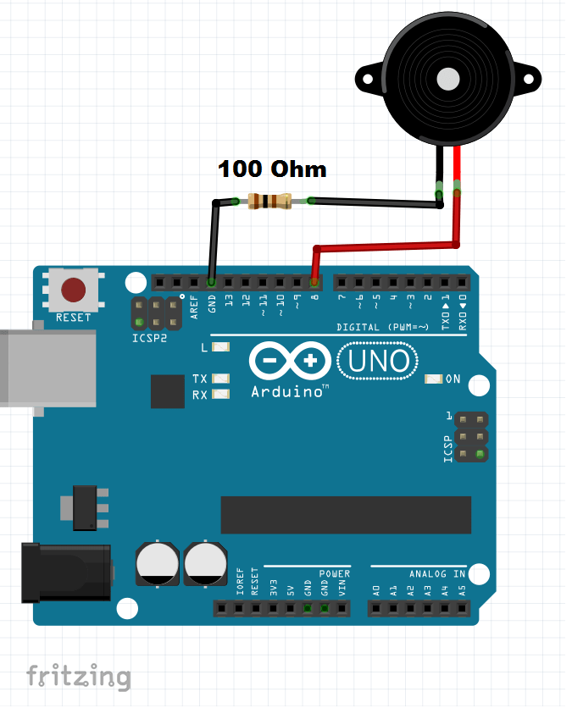
Temperature and Humidity controlled fan

Slide 2
Group-01
Noufel Ahmed Bhuiyan 201916082
Tazwar Siddique 202116095
Umme Saima Humaira Meem 202116096
Umme Shara Malek 202116142

Slide 3
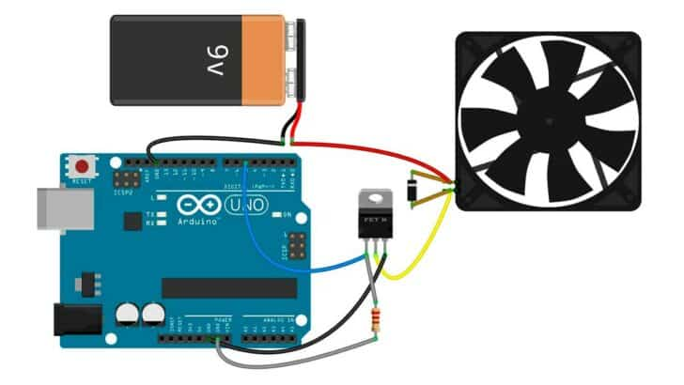
Introduction
A DC fan control system based on high temperatures and humidity is designed and simulated in this project.
An Arduino with a DHT11 temperature and humidity sensor which will monitor the temp and humidity continuously.
The DHT11 Sensor will be used to superintend the fan. By turning on the fan, the room’s sensor parameters will be controlled.
Buzzer will turn on along the change of temp &humidity. The sensor data will be continuously displayed on the serial monitor of the Arduino IDE.

Slide 4
AIM & MOTIVATION
01.
02.
03.
Traditional fans are commonly operated
through manual systems.
These systems utilize rotary switches
with internal
potentiometers for speed control
Automated fan control system,
eliminating the need for continuous
manual intervention and providing a more seamless
and user-friendly experience
With the ever-changing temperature and weather conditions,
users often find themselves manually adjusting the fan
speed at regular intervals. Our project brought ease to this.

Slide 5
Required Instruments
Arduino Uno Microcontroller
DHT11 sensor
L298N Motor Driver
DC Fan
9V Battery
Buzzer
Jumper Cables
Breadboard

Slide 6
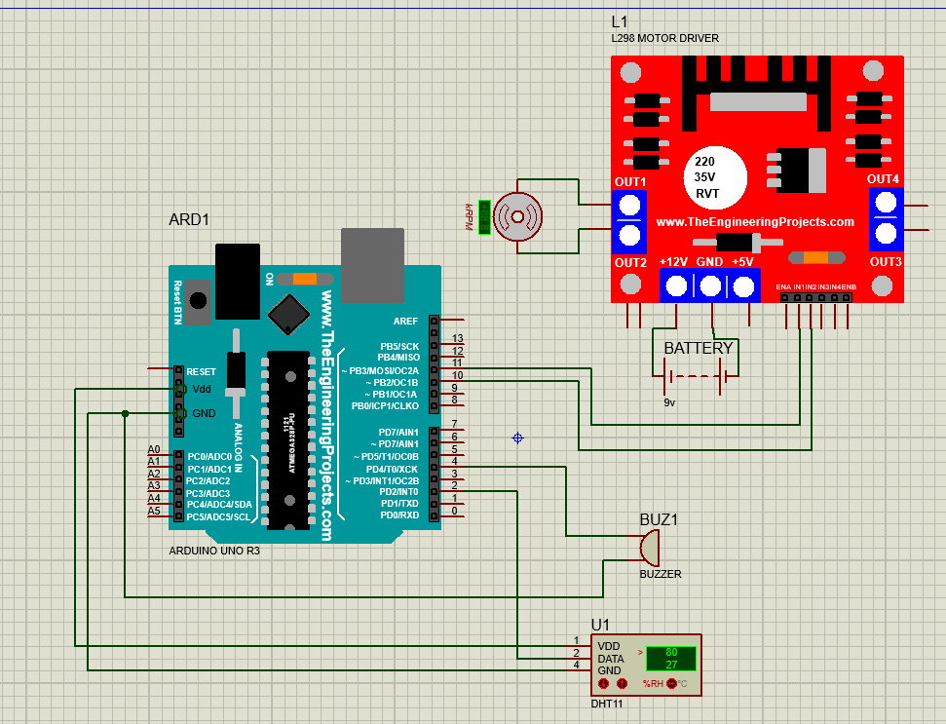
Circuit Diagram

Slide 7
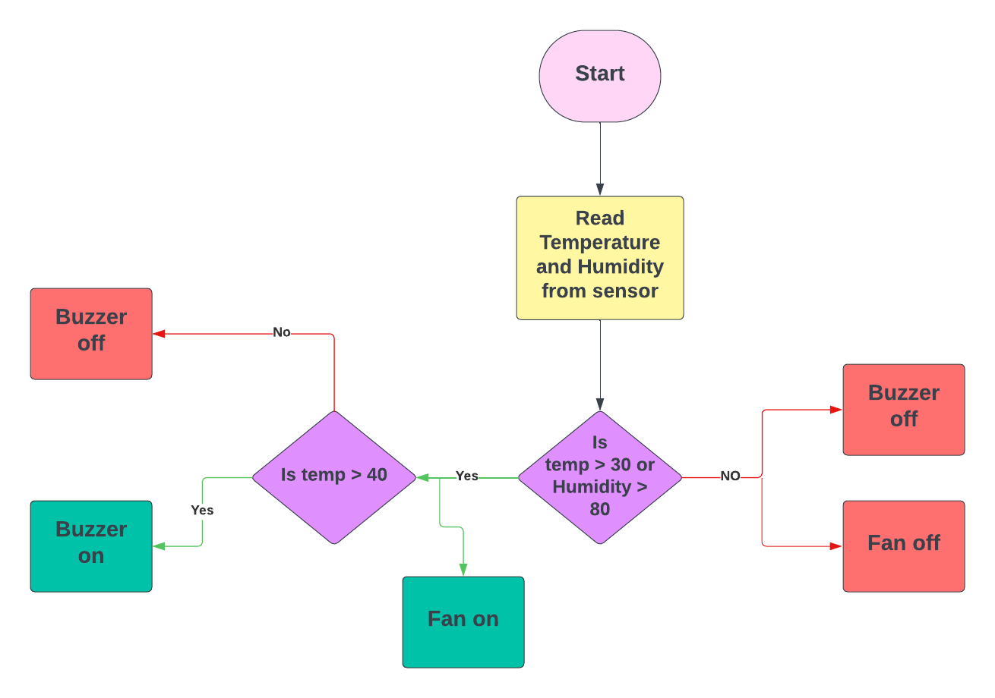
Methodology

Slide 8
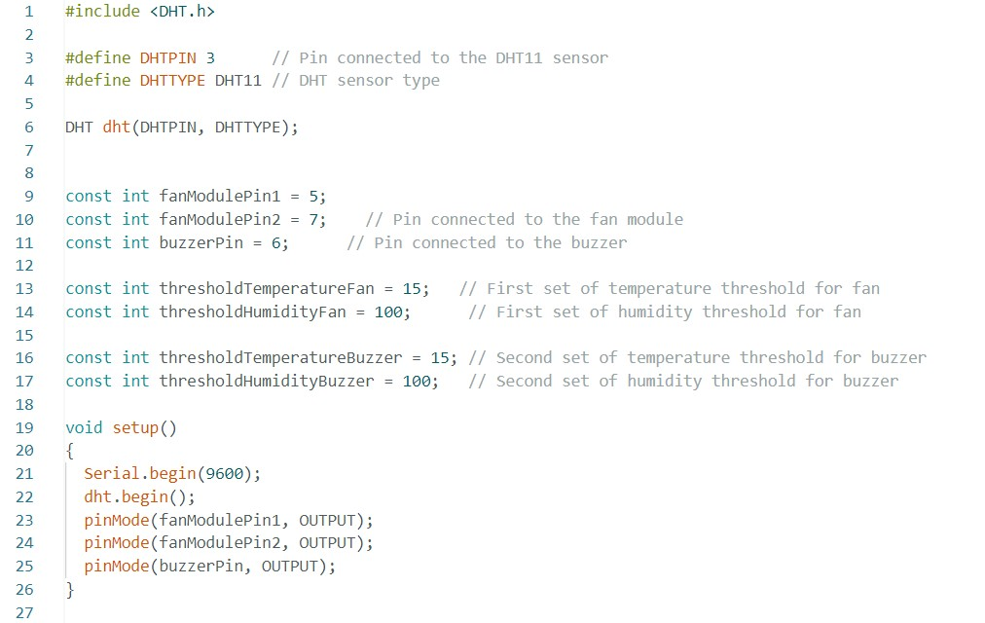
CODES FOR ARDUINO

Slide 9
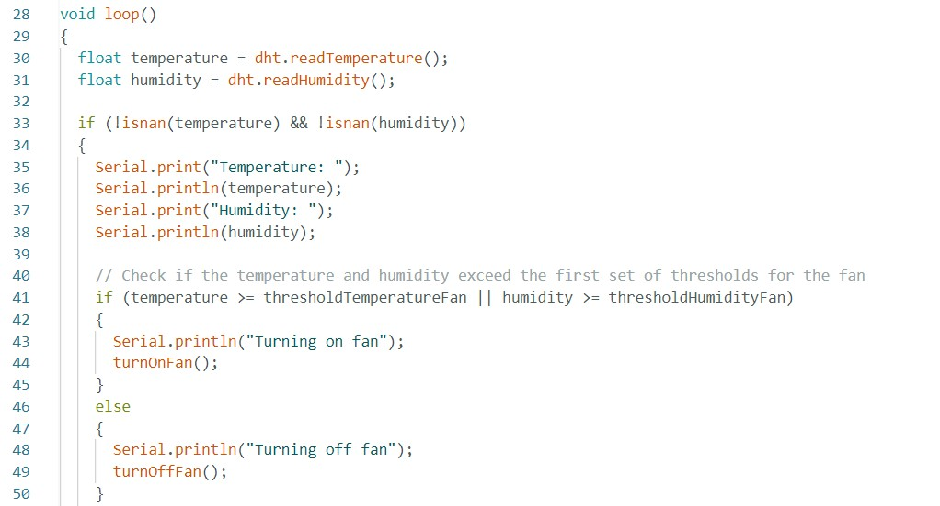

Slide 10
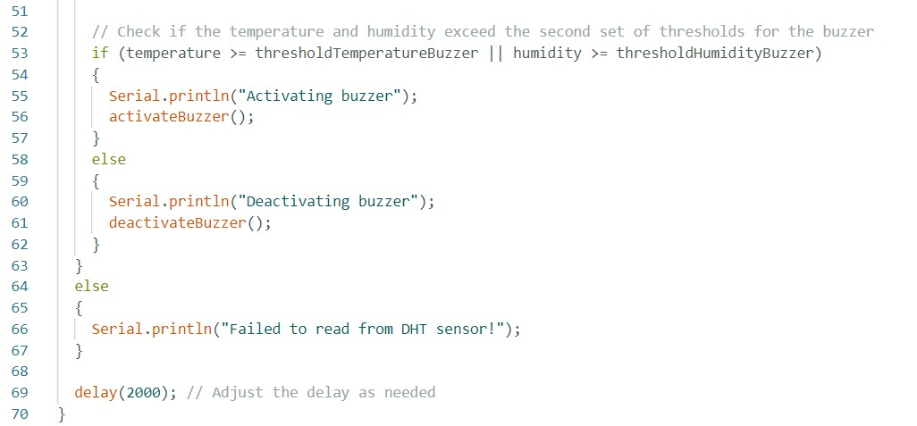
Error Message

Slide 11
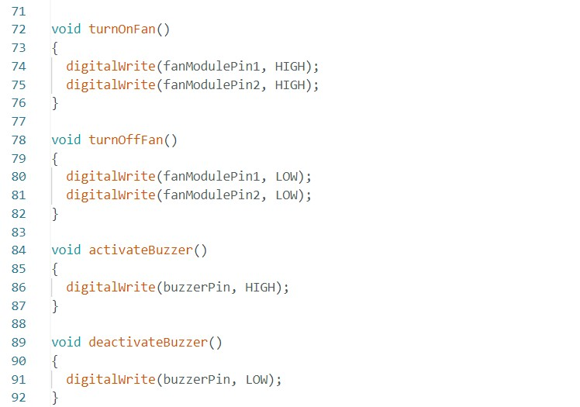

Slide 12
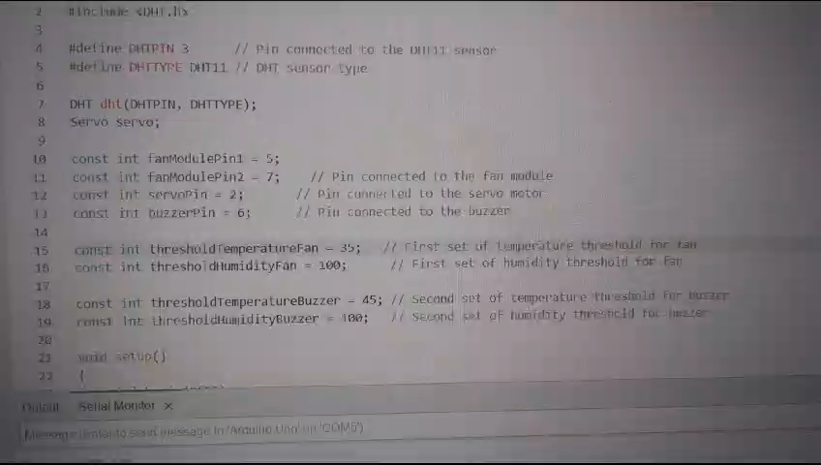
RESULT

Slide 13

Advantages
AUTOMATION OF FAN CONTROL
Saves a lot of man hours
Saves labour costs
Saves energy
Provide optimized comfort
Provide Precision cooling

Slide 14

Application
Air Conditioners
Server Rooms
Greenhouse Climate Control

Slide 15
Conclusion
The Arduino has been effectively programmed to
Regulate the fan speed by comparing the room temperature to a predefined reference temperature.
The automated system activates the fan when the temperature surpasses the set threshold, and it deactivates when the temperature falls below the threshold.
Designed to enhance operational efficiency.

